Slide 1
DEPT. OF COMPUTER SCIENCE AND ENGINEERING
Hit Song Prediction Using Chorus Features
• Course: UE24CS352A – Machine Learning Mini-Project
• Team: [Divisha Guptha, PES1UG24CS158] , [Sharath HG , PES1UG25CS844]
• Section / Problem No. : C / 48
• Adapted from: E. Liu, “Predicting Hit Songs Using Repeated Chorus”, Stanford CS229, Spring 2021
1

Slide 2
Outline
• Problem Statement
• Research Reference: Stanford CS229
• Dataset
• Methodology and Pipeline
• Features and Preprocessing
• Models and Evaluation Protocol
• Results and Analysis
• Code Structure and Live Demo
• Conclusion
2

Slide 3
Problem Statement
Many hit-song studies rely on metadata about the artist or the song. We test whether the audio of a single 15-second chorus is enough to predict a hit.
  • Task: binary classification – hit (1) or non-hit (0).
  • Hit definition: the song appeared on the Billboard Hot 100.
  • Inputs: acoustic features of the chorus only – no artist popularity, social-media signals or other metadata.
  • Goal: a leakage-free pipeline, a fair comparison of seven model families, and honest held-out results.
3

Slide 4
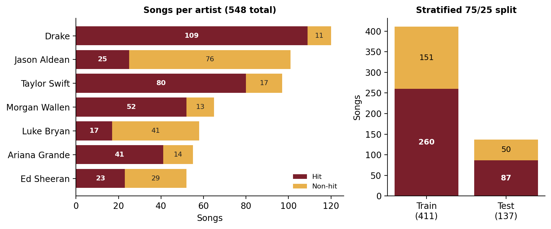
Dataset
• 548 songs from seven artists: 347 hits (63.3%) and 201 non-hits (36.7%).
• Hit (1): appeared on the Billboard Hot 100. Non-hit (0): other album tracks by the same artists.
• Split: stratified 75/25, random_state=42 → 411 training songs (260 hits, 151 non-hits) and 137 test songs (87 hits, 50 non-hits), with no overlap.
• Baseline: always predicting “hit” on the test set gives 63.5% accuracy (87 of 137).
Figure: songs per artist (hits vs. non-hits) and the stratified train/test split.
4

Slide 5
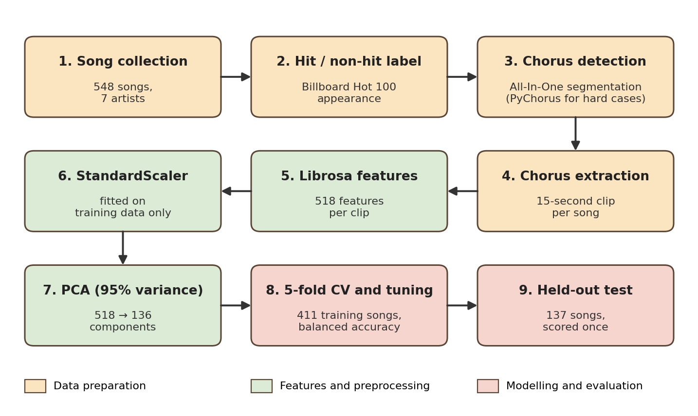
Methodology: End-to-End Pipeline
• Scaling, PCA and tuning use the training songs only.
• The 137-song test set is scored once, at the end.
5

Slide 6
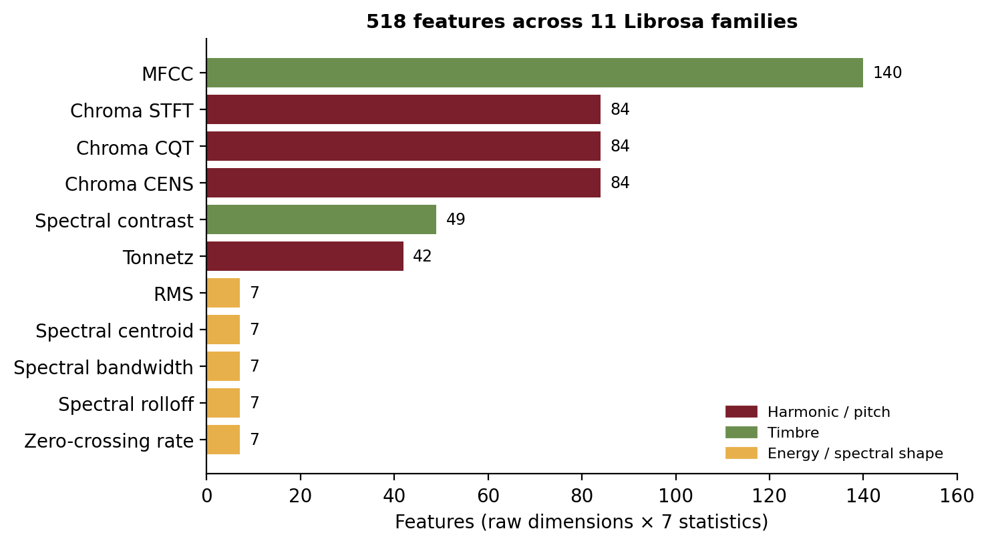
Features: 518 Librosa Descriptors per Chorus
• Each 15-second clip is described by 11 Librosa feature families (74 raw dimensions per time frame).
• Every raw dimension is summarised by 7 statistics: minimum, mean, median, maximum, standard deviation, skewness and kurtosis.
• 74 × 7 = 518 features per song, independent of clip length and sampling rate (same dimensionality as Stanford).
Figure: feature count per Librosa family; the 11 families add up to 518.
6

Slide 7
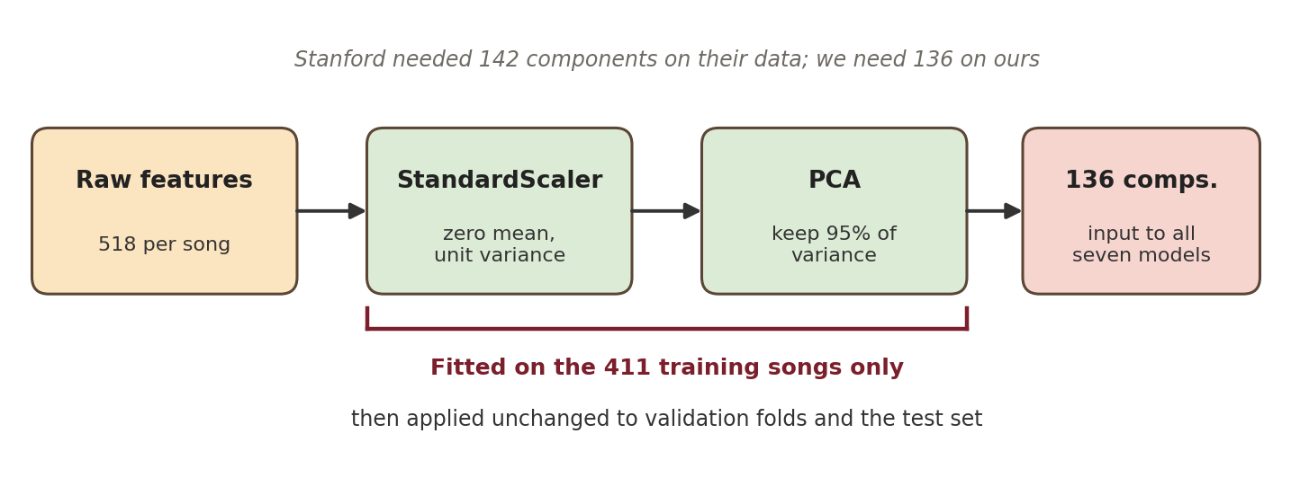
Preprocessing: StandardScaler and PCA
• StandardScaler: puts all 518 features on a common scale.
• PCA: keeps the components explaining 95% of the variance – 518 features → 136 components.
• Why reduce: 411 training songs against 518 correlated features invites overfitting.
7

Slide 8
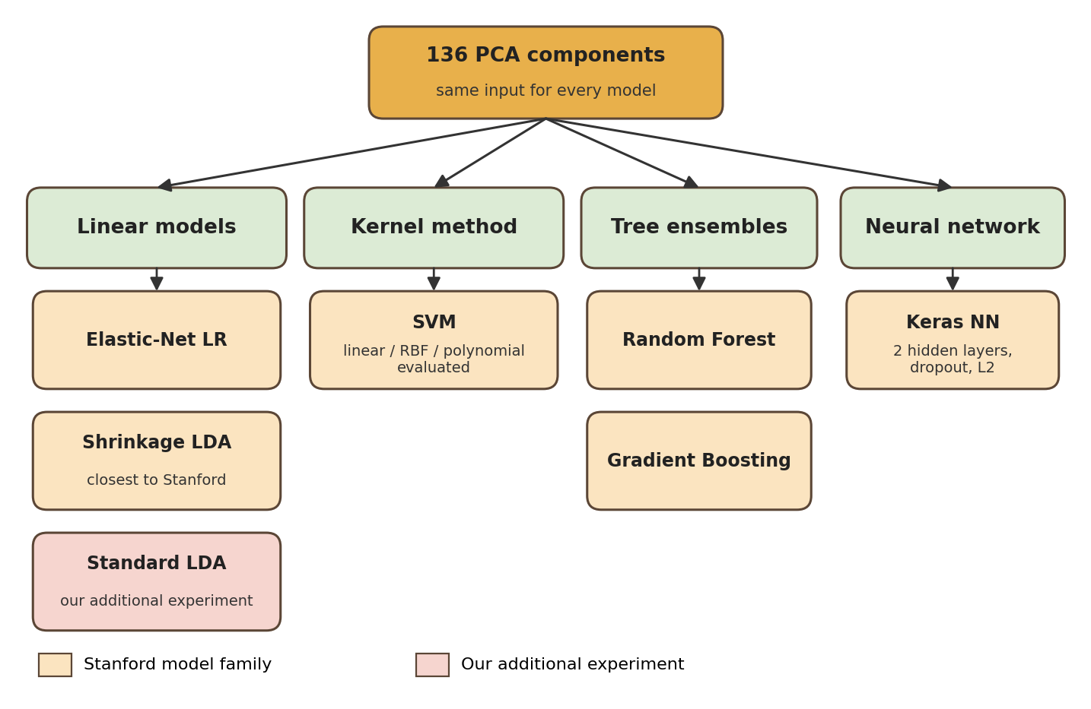
Models
• Shrinkage LDA is the Stanford-style model: the covariance is shrunk toward a scalar matrix.
• Standard LDA is our additional experiment, to check whether shrinkage was needed. Both are reported.
• SVM: linear, RBF and polynomial kernels were evaluated.
• Keras NN: two hidden layers, dropout and L2 regularisation.
8

Slide 9
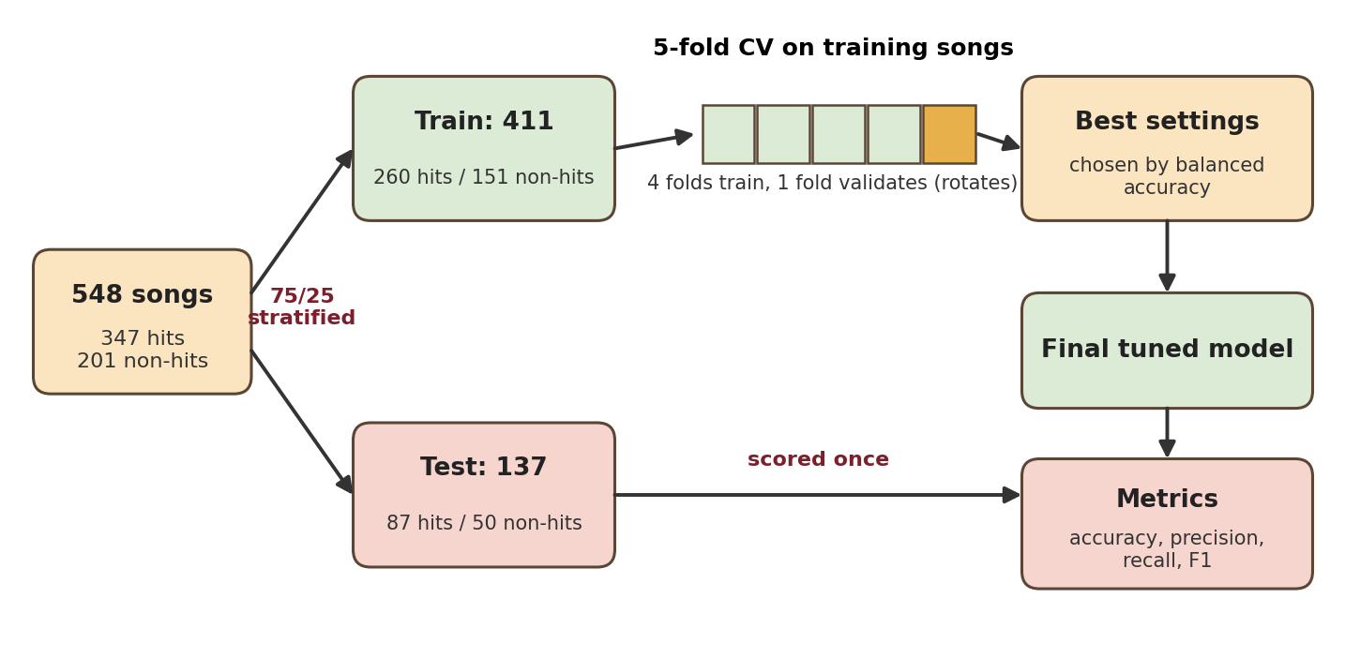
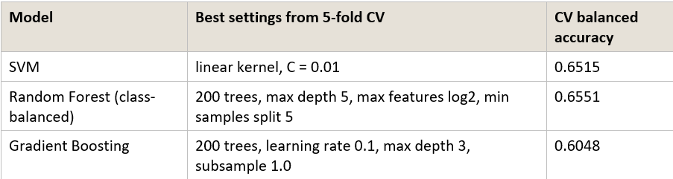
Tuning and Evaluation Protocol
• Tuning metric: balanced accuracy, because hits outnumber non-hits 347 to 201.
• Test metrics: accuracy, precision, recall and F1.
9

Slide 10
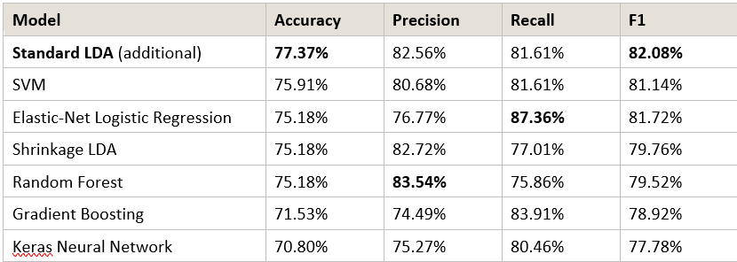
Slide 10: Results on the 137 Held-Out Songs
Figure: test accuracy, precision, recall and F1 for every model.
10

Slide 11
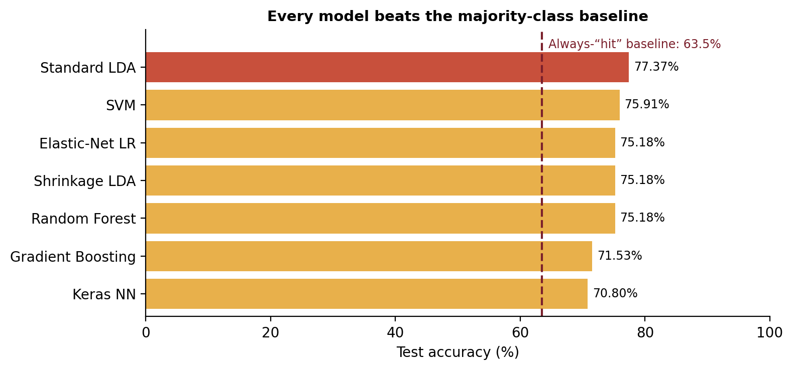
Results on the 137 Held-Out Songs
• Best accuracy and F1: Standard LDA. Best recall: Elastic-Net LR. Best precision: Random Forest.
10

Slide 12
Conclusion
• Chorus-only audio carries real signal: best test accuracy 77.37% and F1 82.08%, against a 63.5% always-“hit” baseline.
• Standard LDA scored best; SVM, Elastic-Net LR, shrinkage LDA and Random Forest were close (75.18–75.91% accuracy).
• Simpler models generalised better than the neural network and Gradient Boosting on this small dataset.
Thank you
13

